Slide 1
Multi-Environment Characterization of
28GHz Millimeter Wave Channels Using
Wireless InSite
Members
Abhiram Chowdary 222CN011
Under the guidance of
Dr. Ashvini Chaturvedi Professor,Nitk

Slide 2
Problem Statement and Motivation: 1.The deployment of 28GHz millimeter-wave communication systems is a promising solution for achieving high data rates and low latency in future wireless networks. 2. The unique characteristics of mmWave frequencies, such as severe path loss and susceptibility to environmental factors, present significant challenges to effective channel estimation techniques. 3. To ensure the successful implementation of 28GHz millimeter-wave technology, it is crucial to conduct a multi-environment characterization of the channels. 4.Our research will specifically focus on three distinct environments – indoor, urban, and remote areas – as the simulation model for investigating the channel characteristics of 28GHz millimeter-wave communication systems. The goal is to gain a comprehensive understanding of the unique challenges and dynamics presented by each of these scenarios in order to enhance the performance and reliability of the communication systems deployed in such diverse settings.

Slide 3
Overview
In this presentation, we introduce mmWave technology and explore the simulation capabilities of Wireless InSite.
We model indoor, urban, and remote scenarios to observe 28GHz mmWave channel characteristics, examining received power, throughput, and path results.
Our discussion extends to future works, outlining our ongoing and upcoming research directions.

Slide 4
Exploring the Dynamic World of 28GHz Millimeter-Wave Channels
Millimeter-wave (mmWave) refers to the band of electromagnetic spectrum with wavelengths ranging from 1 millimeter to 10 millimeters, corresponding to frequencies between 30 gigahertz (GHz) and 300 GHz. In the context of wireless communication, the mmWave spectrum is particularly significant for its potential to support high data rates, low latency, and massive device connectivity. It plays a crucial role in the development and deployment of advanced wireless communication technologies, including 5G and beyond.
Key features:
High frequency and short wavelength
High data rates
susceptible to higher path loss and are more easily absorbed by atmospheric gases and rain
Benefits and Applications:
Enhanced Capacity
High-Speed Internet Access
5G Networks

Slide 5
Standards Shaping mmWave Communication:
5G NR (New Radio):
Developed by 3GPP
Defines air interface, modulation schemes, and protocols for mmWave communication
Includes frequency bands around 28 GHz and 39 GHz
IEEE 802.11ad/ay (WiGig):
Developed by IEEE
Encompasses 802.11ad and 802.11ay standards
Focuses on 60 GHz band for high-speed, short-range communication
Used in applications like wireless networking, virtual reality, and augmented reality

Slide 6
Wireless InSite Simulation Capability:
Wireless InSite offers advanced simulation capabilities for radio wave propagation in complex environments.
This tool enables accurate modeling of electromagnetic wave behavior, including diffraction, reflection, and scattering.
Its simulation prowess extends to various scenarios such as indoor, urban, and remote environments, allowing for the study of channel characteristics at different frequencies, including mmWave.
Wireless InSite's power lies in its ability to provide realistic insights into signal propagation, aiding in the optimization of wireless communication systems for enhanced performance and reliability.
Overall it is a great tool for simulate the channel model for complex environments .

Slide 7
Uses of wireless insite:
Network Optimization
Wireless Network Planning
Cost Savings
Efficient Resource Allocation
Research and Development
Realistic Simulations
Wireless Network Planning
IoT Connectivity
5G Network Deployment
Environmental Impact Assessment

Slide 8
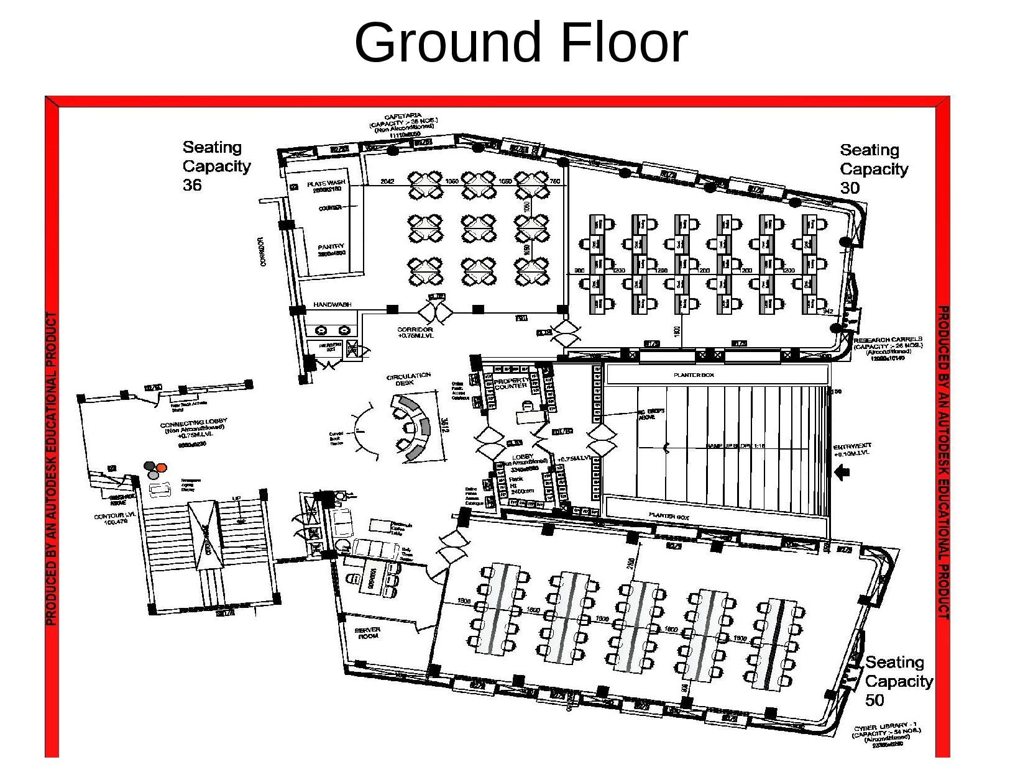
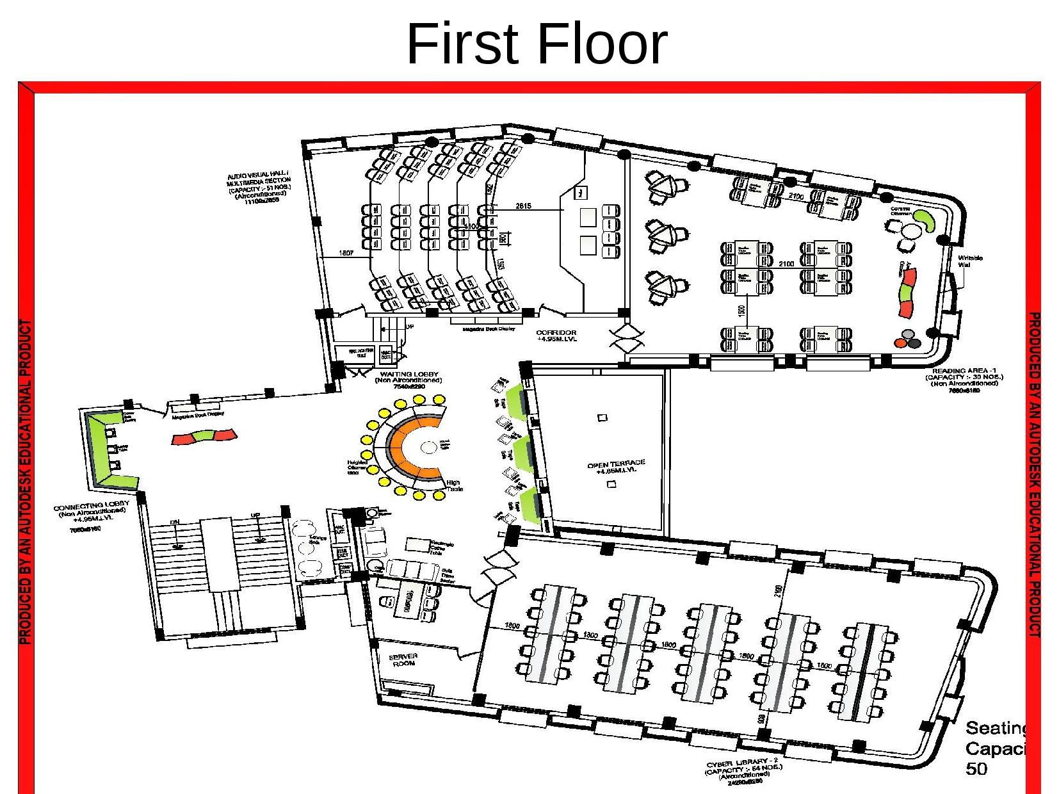
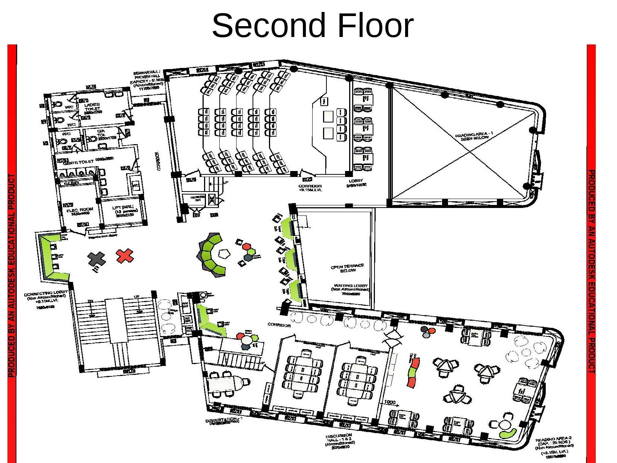
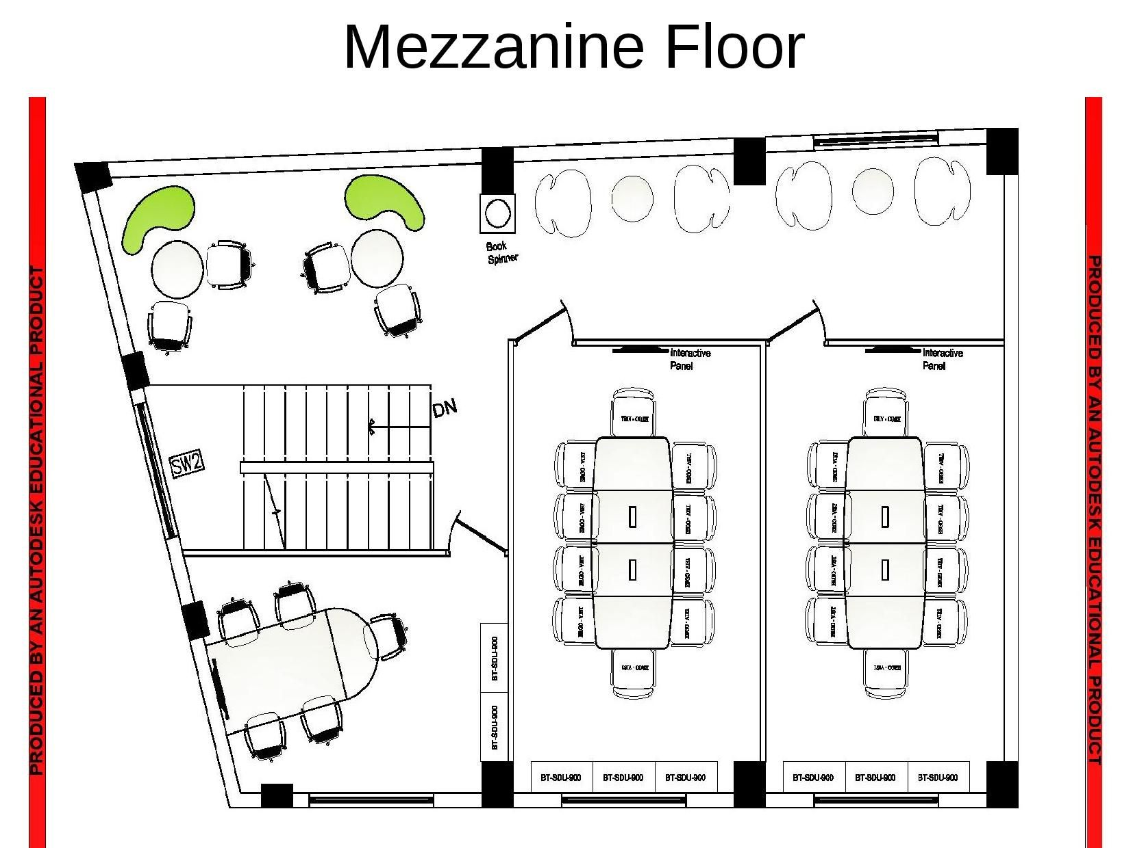
Simulation:
For indoor simulation we have taken nitk elibrary as our model which has 30mx30m area and 3m height each floor,it consists of 4 floor below are the floor plan for then:

Slide 9
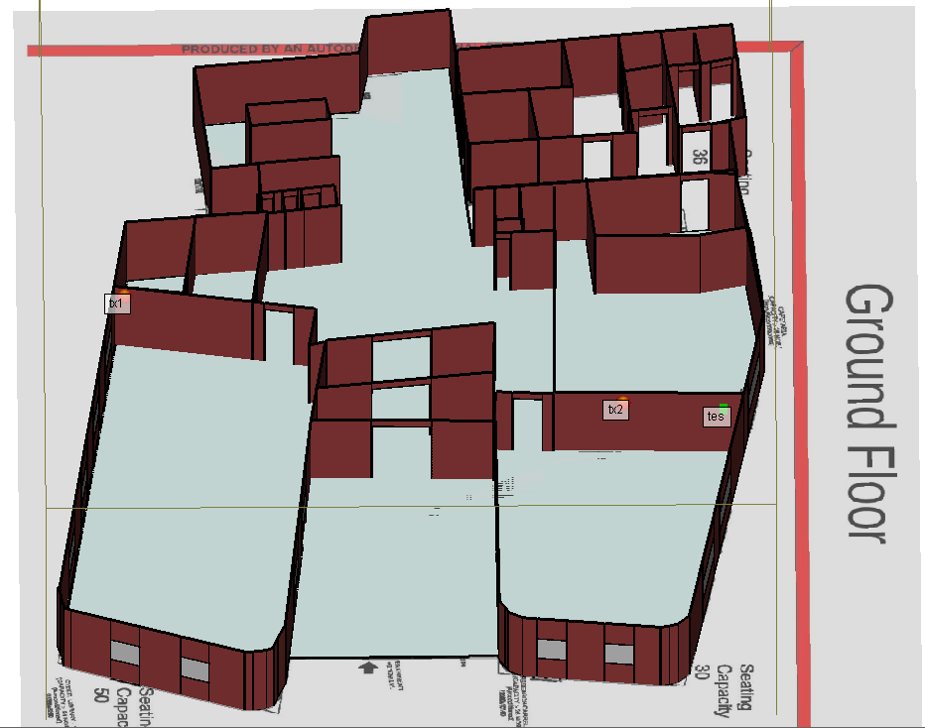
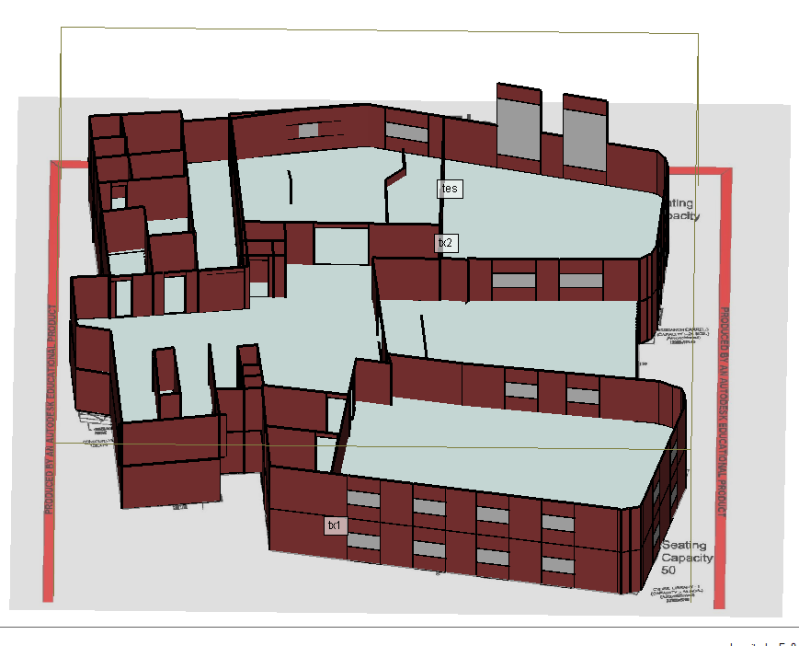
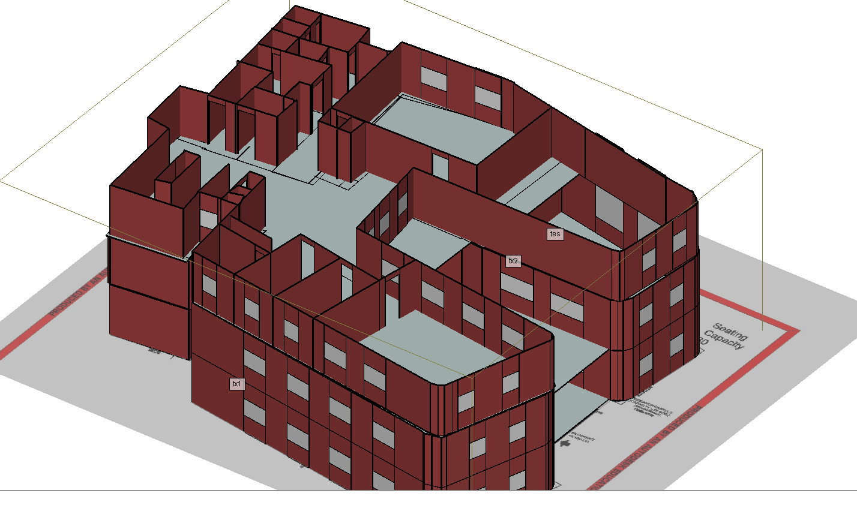
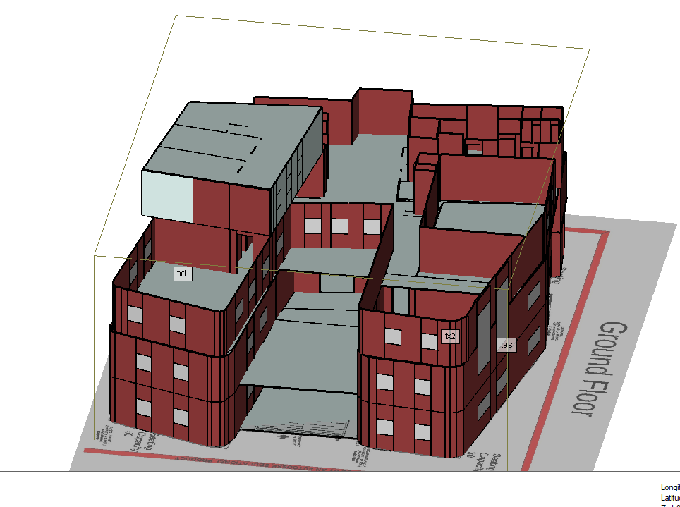
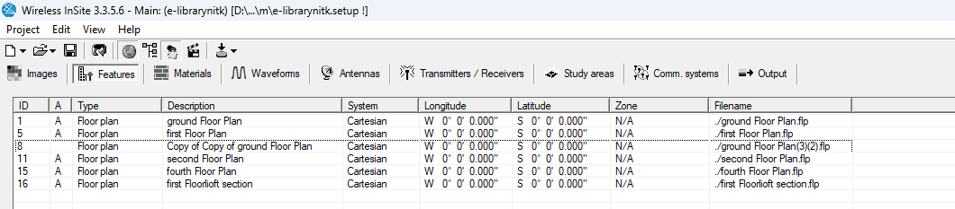
Indoor modeling

Slide 10
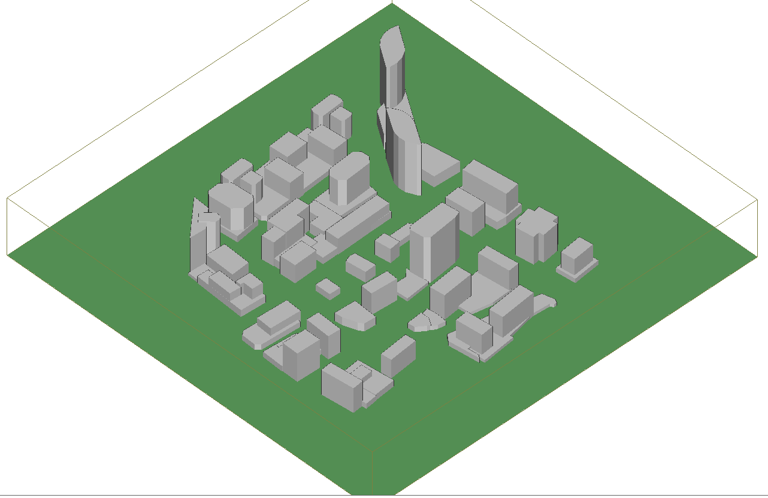
Urban area modelling:
for urban scenario we took model of Rosalyn Urban neighborhood in Arlington, Virginia,USA, from wireless insite.it has area of 500mX500m

Slide 11
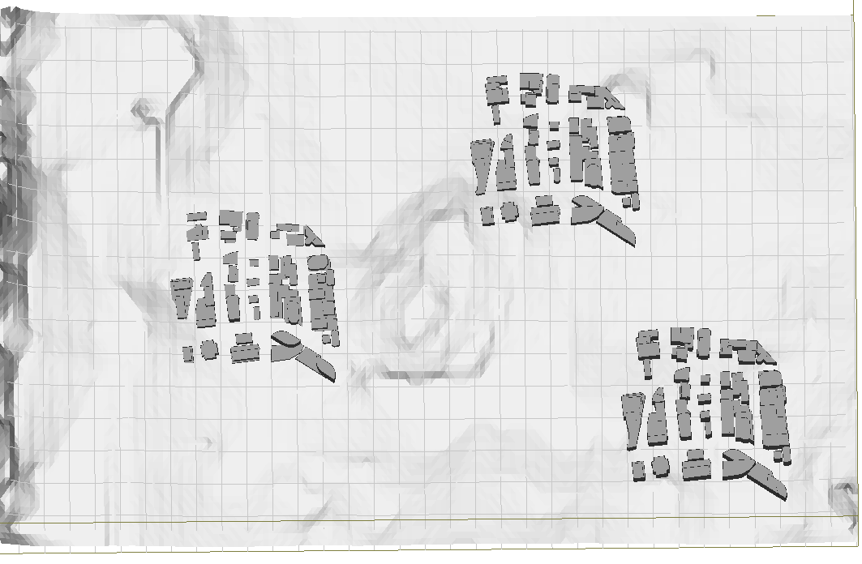
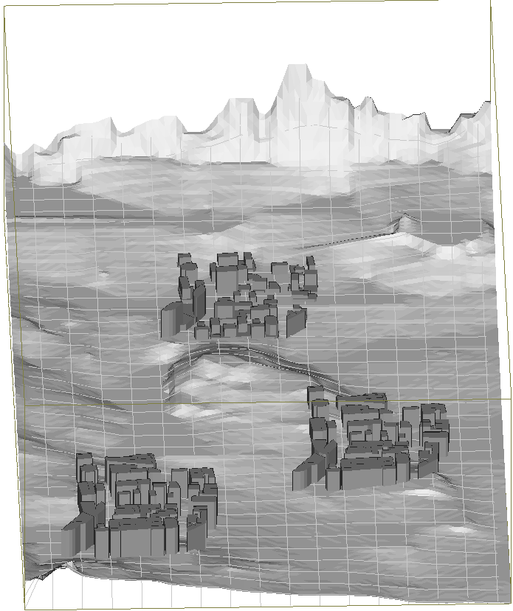
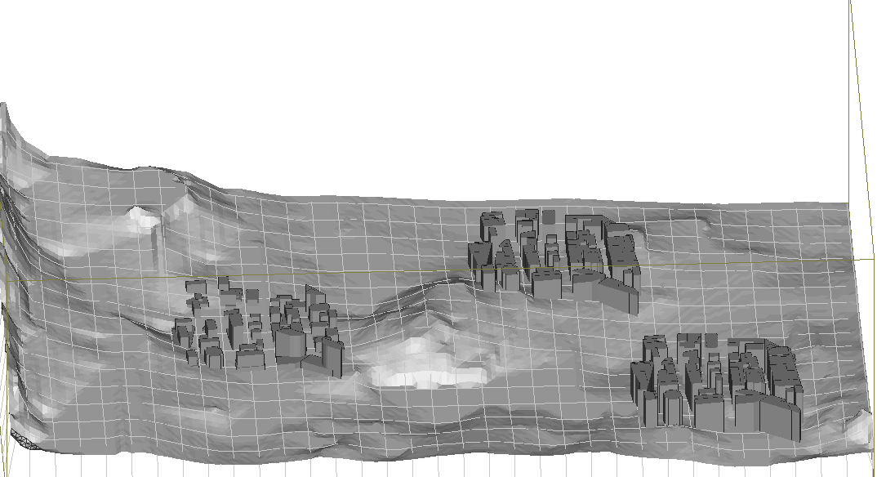
Remote Area modelling:
we’ve incorporated three distinct cities, each spanning an area of 500m by 500m, and strategically positioned them at varying elevations.

Slide 12
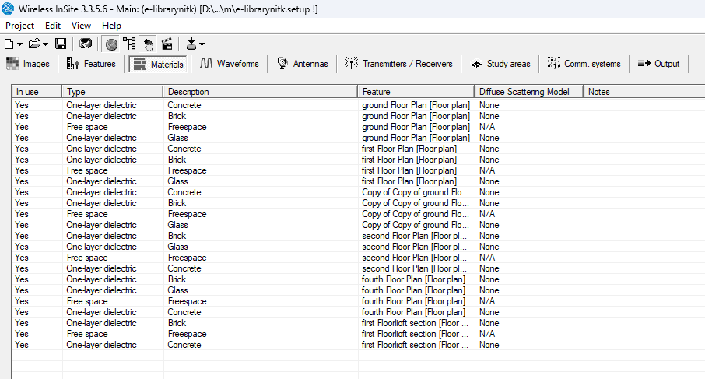
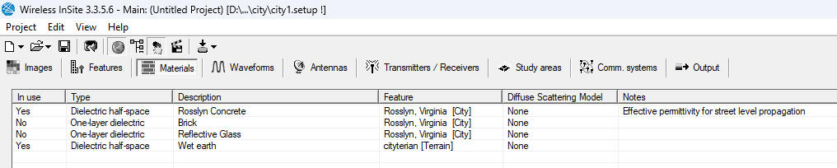
Material used
Here are material list of indoor and urban area,In
material properties each material has permittivity
Conductivity and thickness as it primary meatrics.

Slide 13
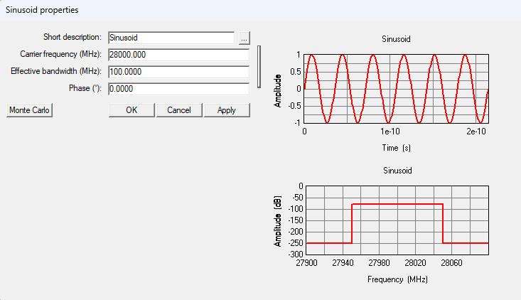
Waveform:
Since we have selected 28Ghz frequency with 100Mhz bandwidth,as par option available in wireless insite we have selected sinusoidal wave for our simulation

Slide 14
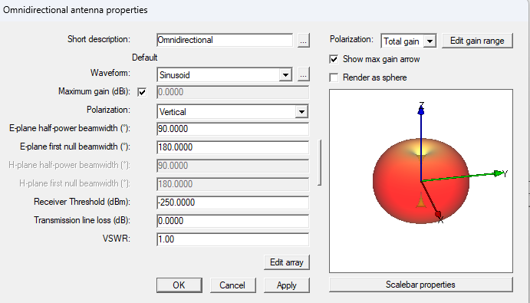
Antenna
Since we are going to study channel characteristics we have used omnidirectional antenna for for better directional coverage

Slide 15
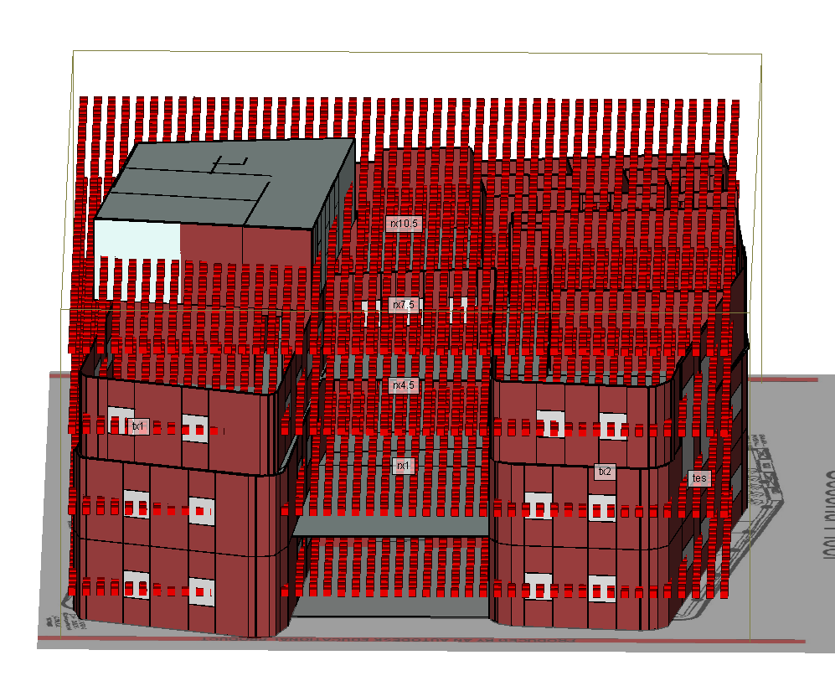
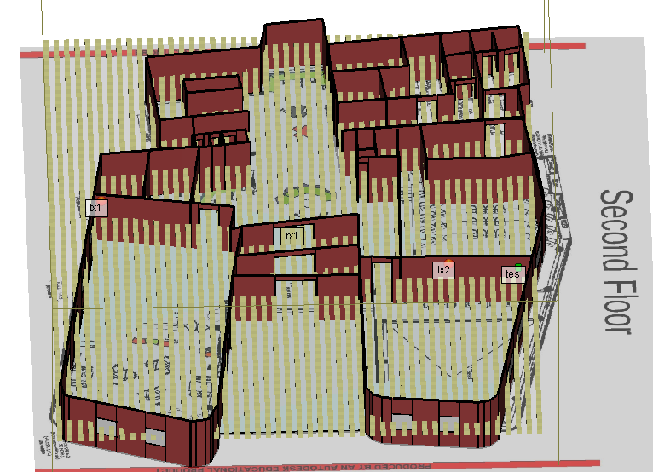
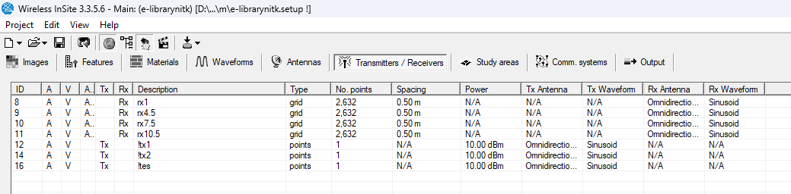
TX and RX in indoor simulation
here we can see 2632 receiver with 5m spacing in every floor and 3 transmitter in groud floor

Slide 16
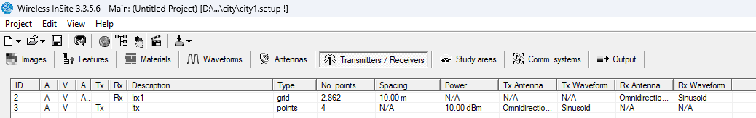
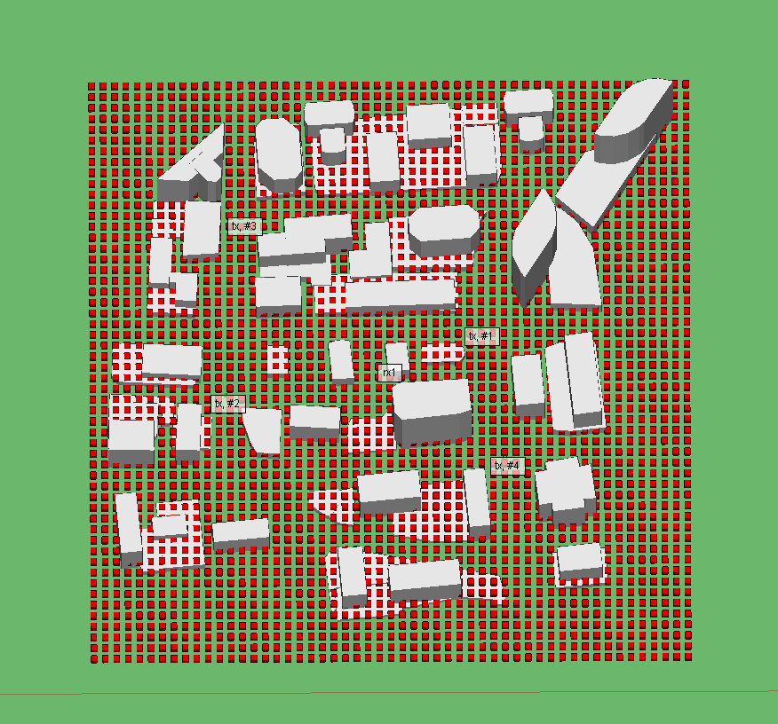
TX and RX for urban simualtion:
Here there are 2862 Rx with 10m spacing and 4tx

Slide 17
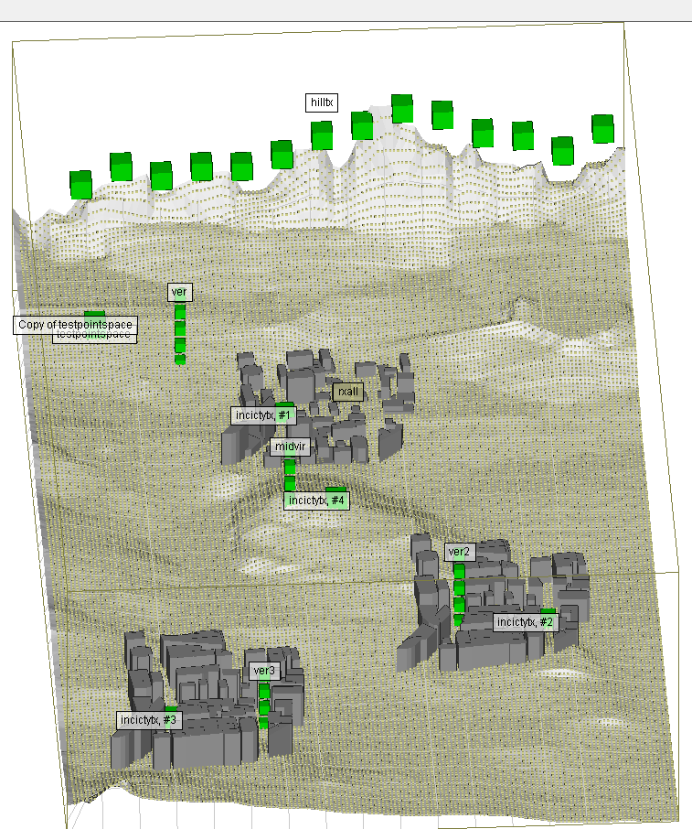
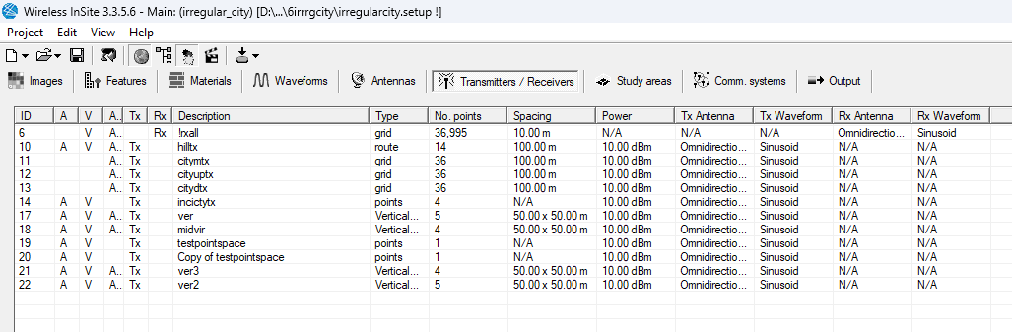
Tx and Rx for remote area simulation:

Slide 18
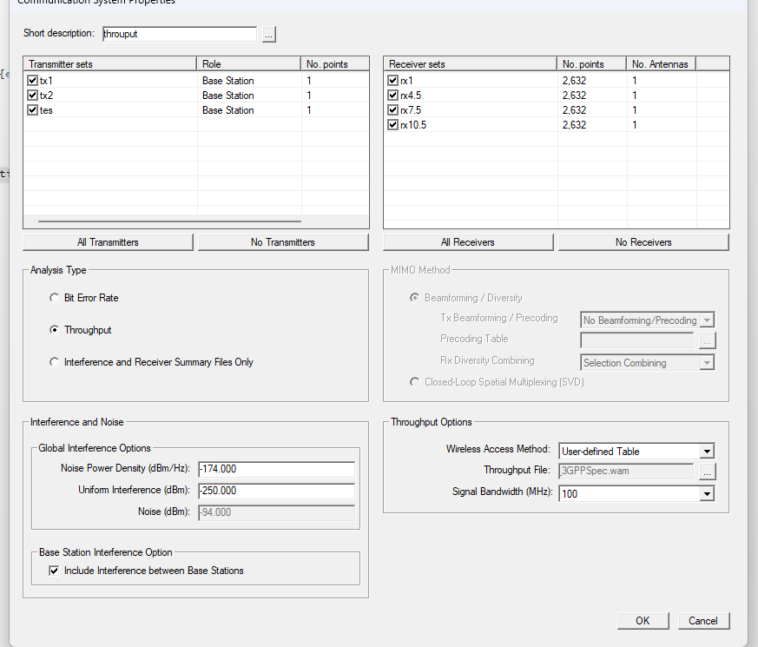
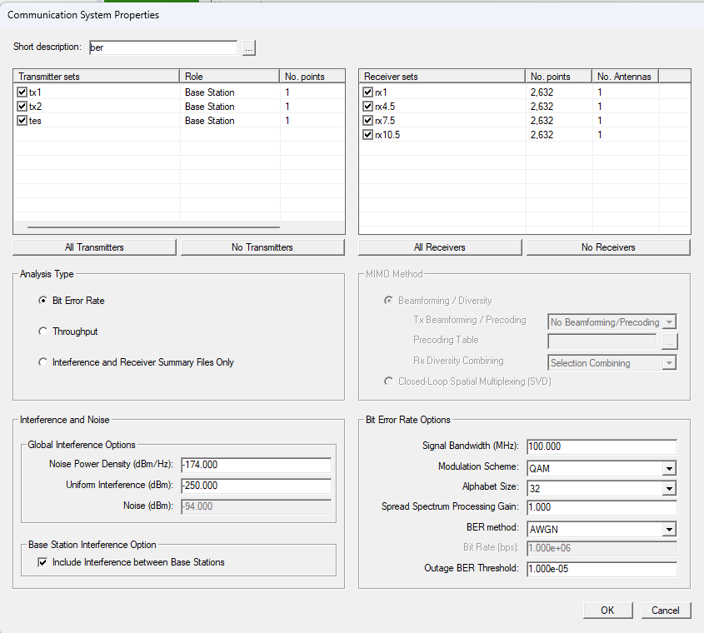
Communication system:
Communication system is feature or tool offered by wireless insite on which we can calculate throughput ,BER and interference and noise.

Slide 19
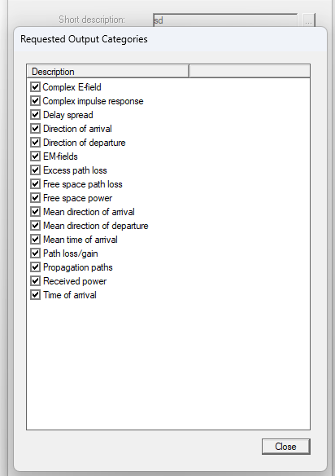
Study area:
Study area is a feature in wireless insite which is used to conduct different section of model as group for simulation and it also keep track output which you request

Slide 20
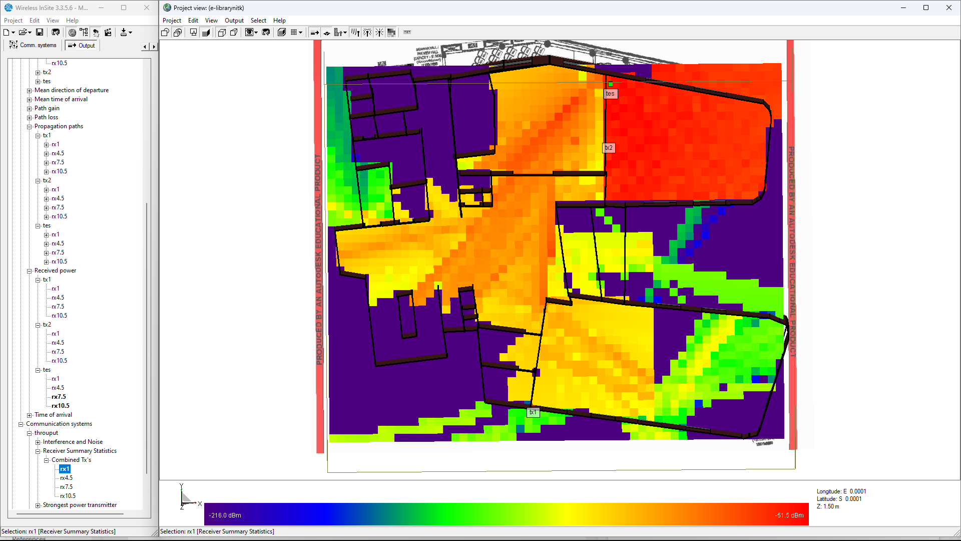
Results:
Below we are seeing Indoor simulation received power output ,below fig shows Tx combined received power heat map

Slide 21
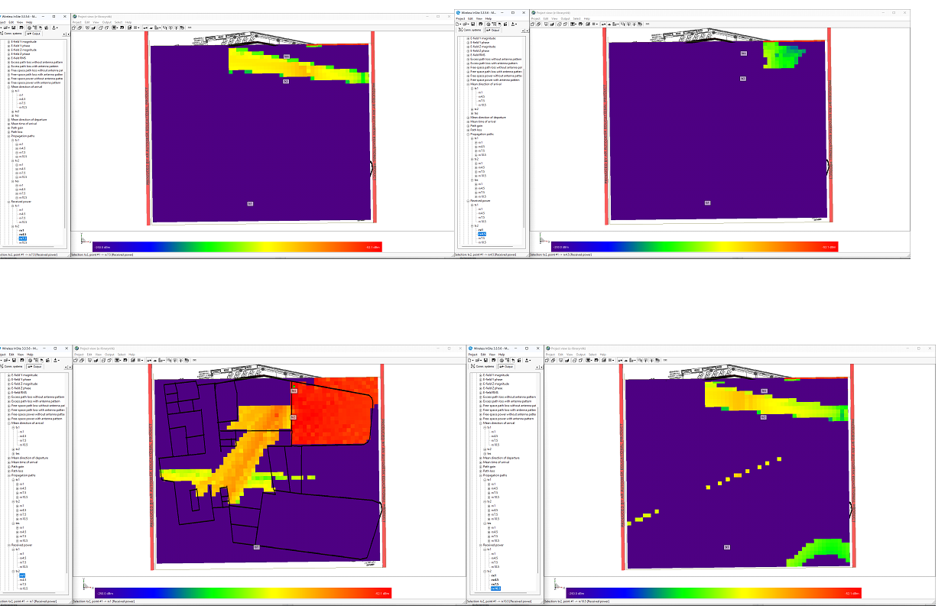
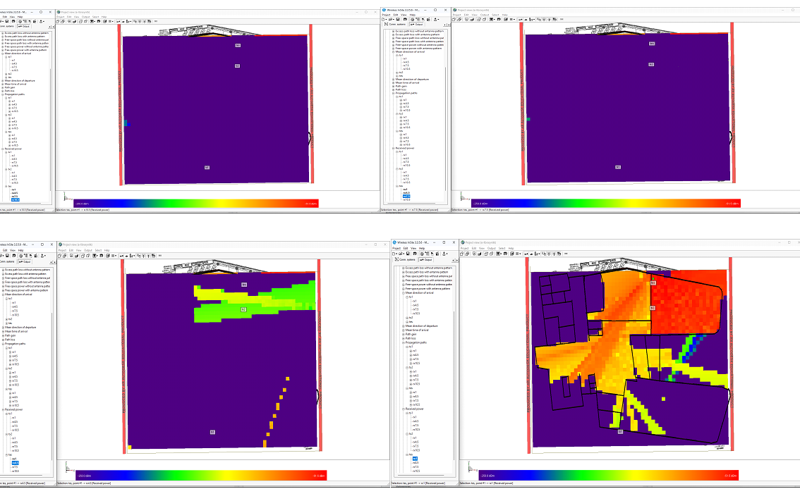
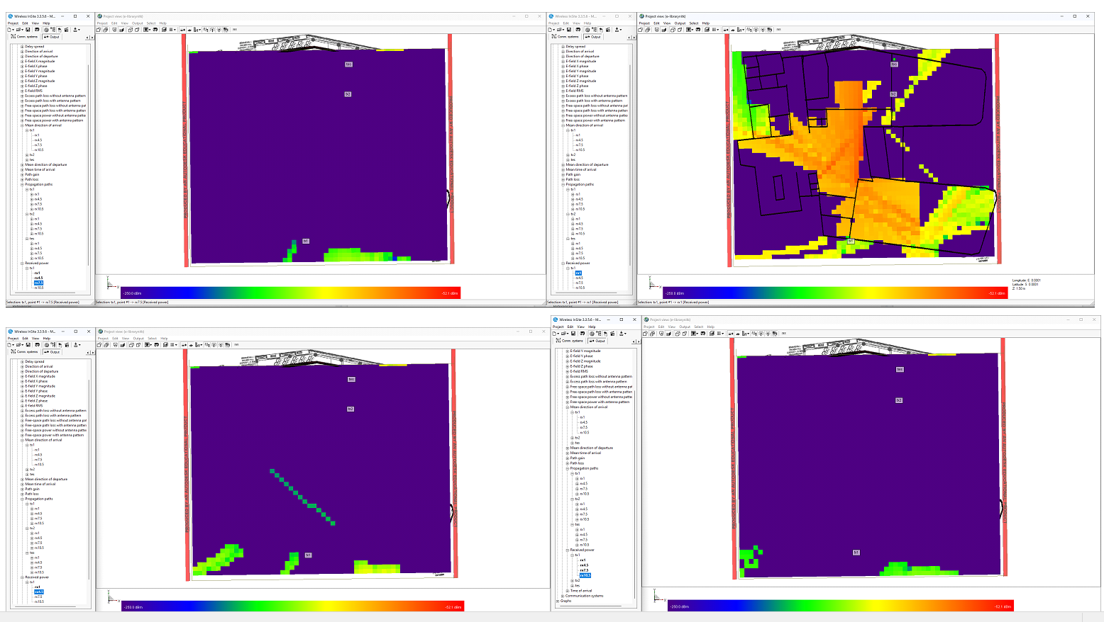
Here are indoor received power result for different tx in order of ,tx2,tes,tx1

Slide 22
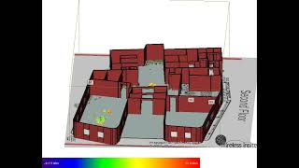
Propagation path in indoor:

Slide 23
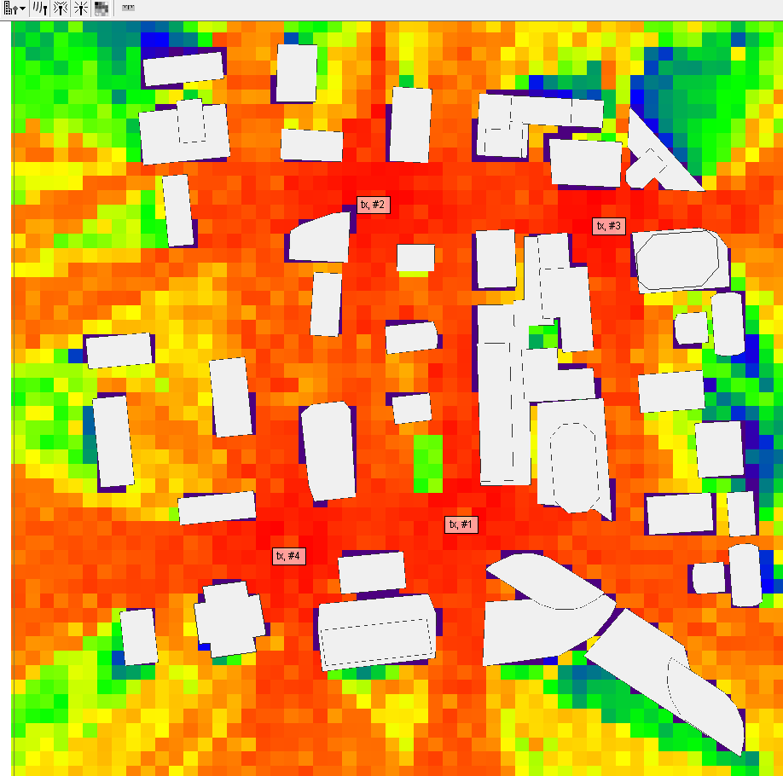
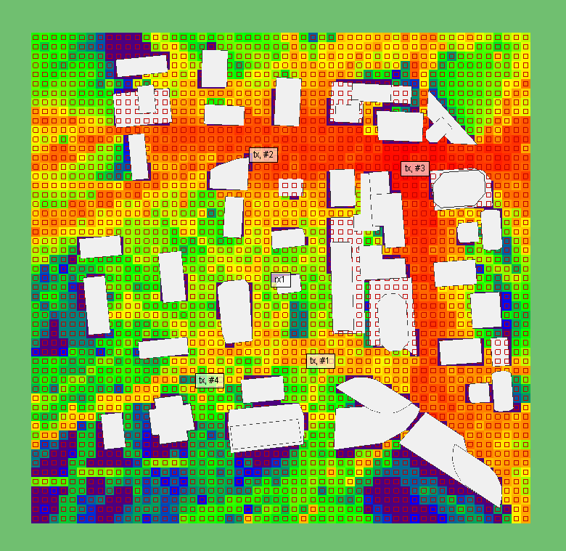
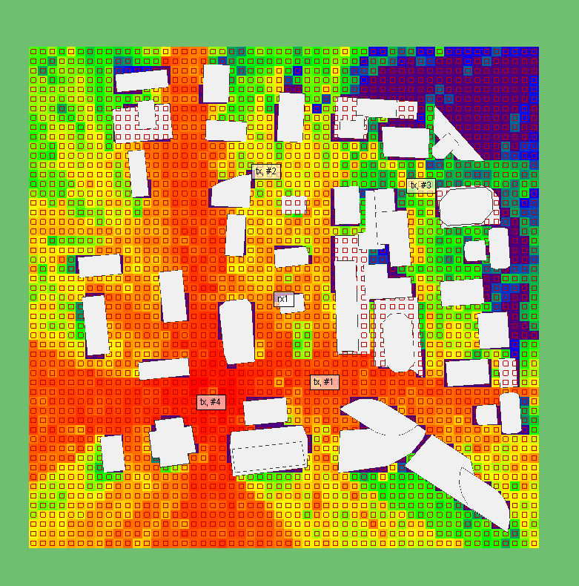
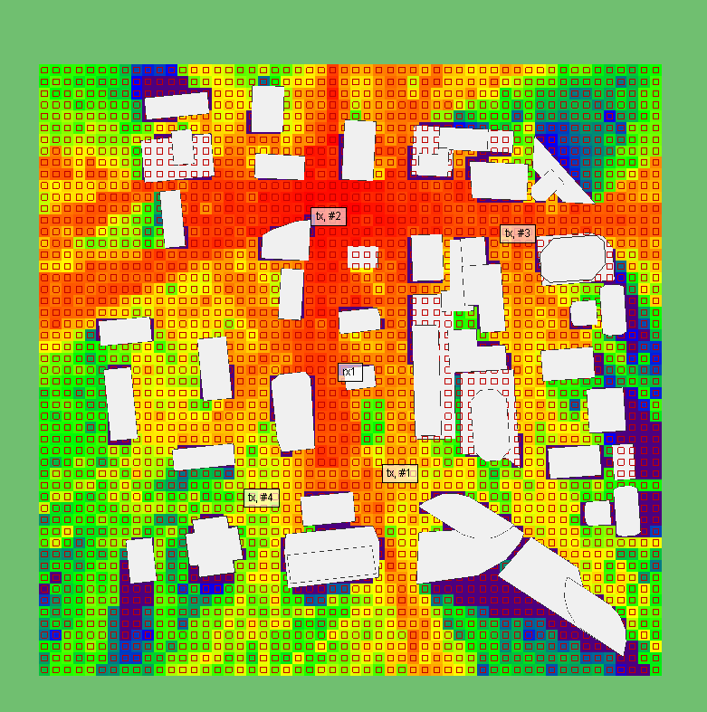
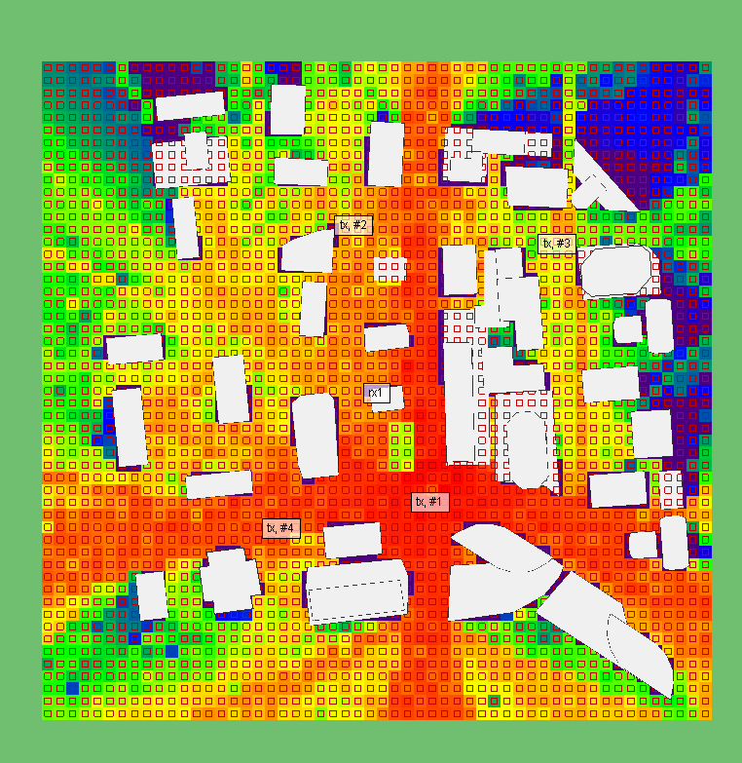
Urban area received power results:

Slide 24
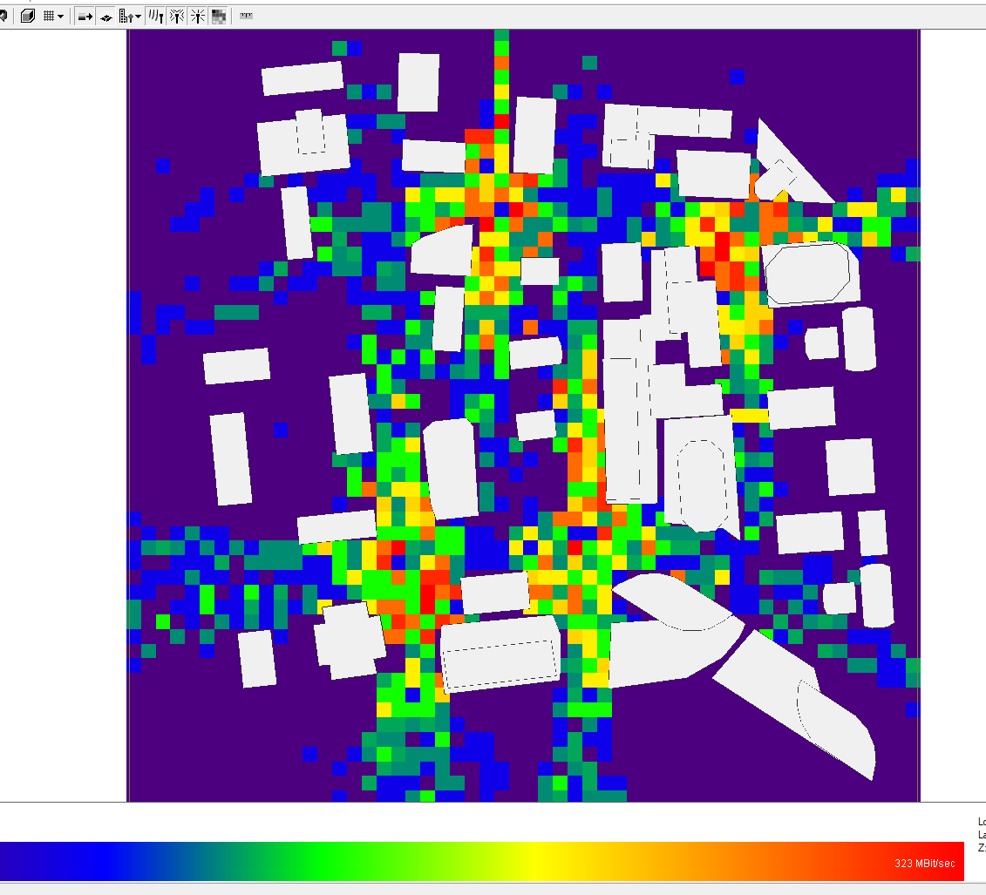
Throughput for urban area:
Range 1mb/sec - 323mb/sec

Slide 25
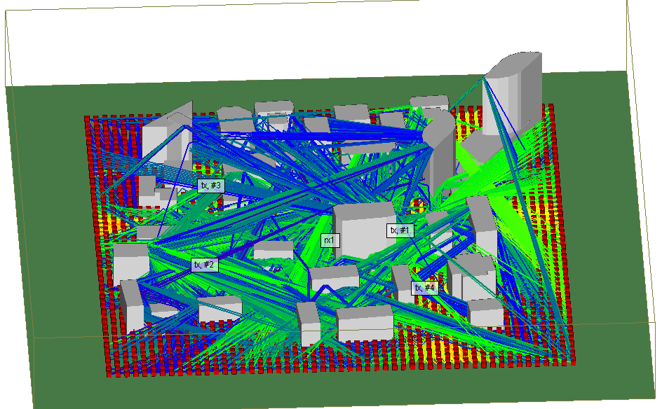
Propagation path in urban area:
For tx1

Slide 26
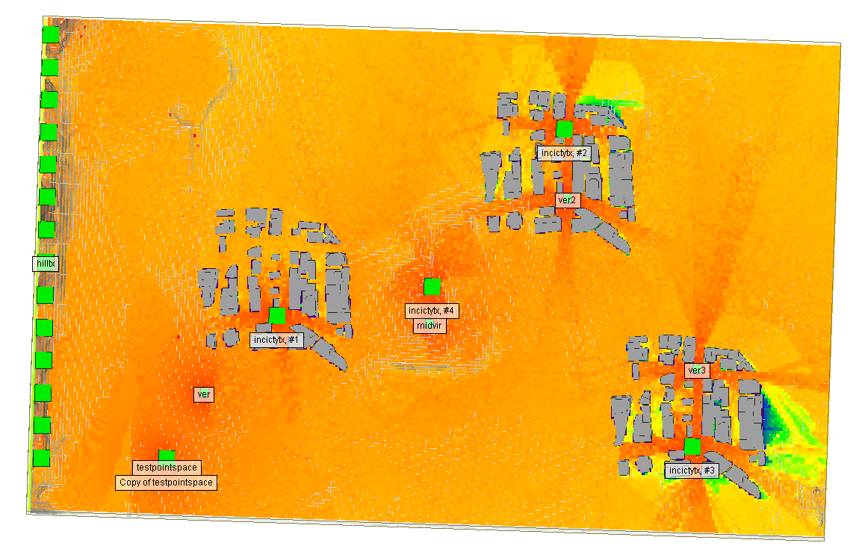
Combined Tx received power in outdoor area:

Slide 27
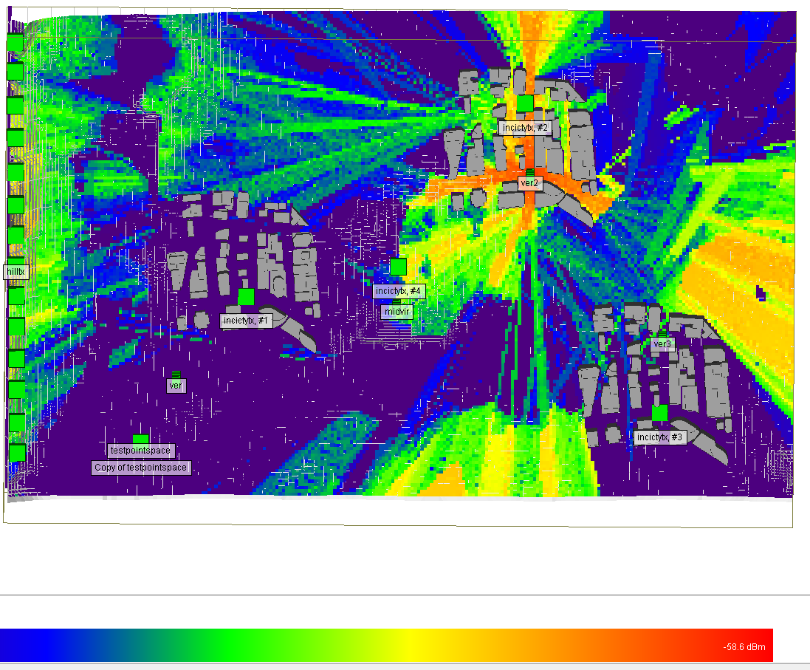
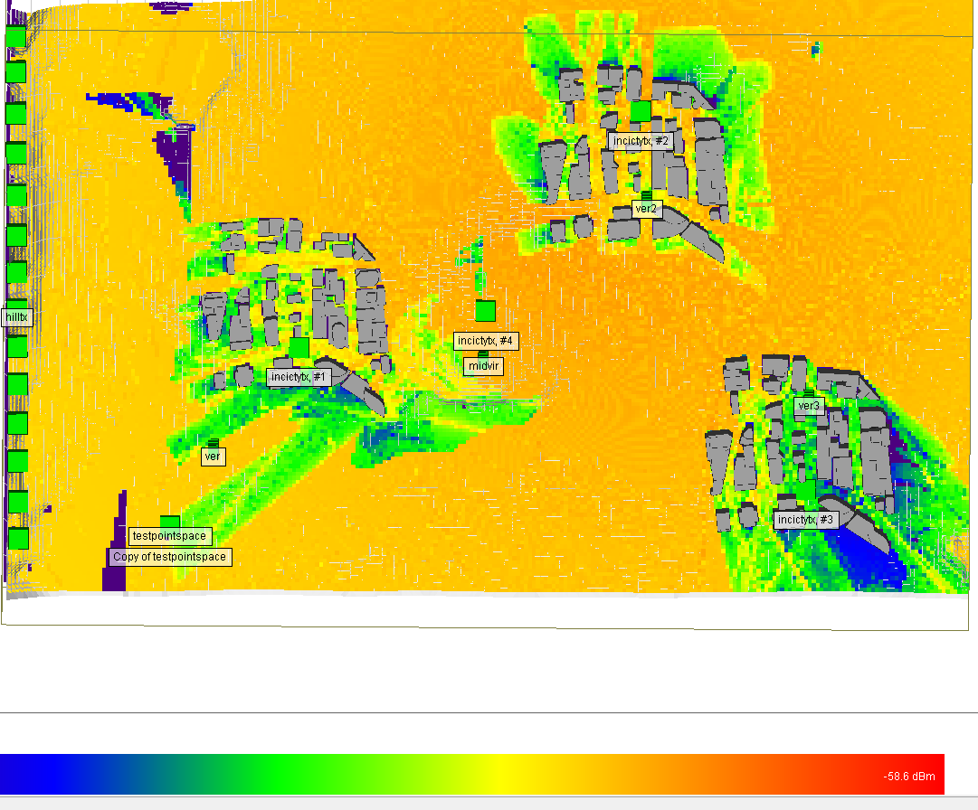
Received power comparison with different height antenna:with 5m and 200m

Slide 28
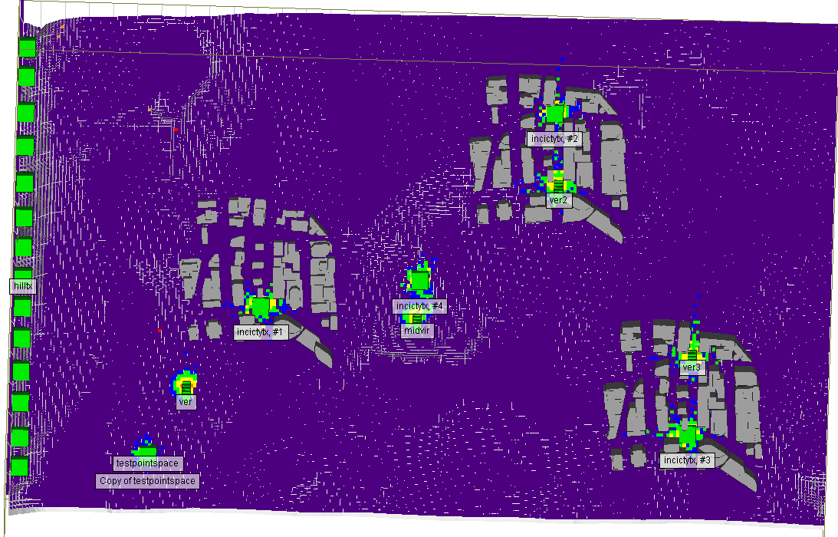
Throughput for outdoor area:

Slide 29
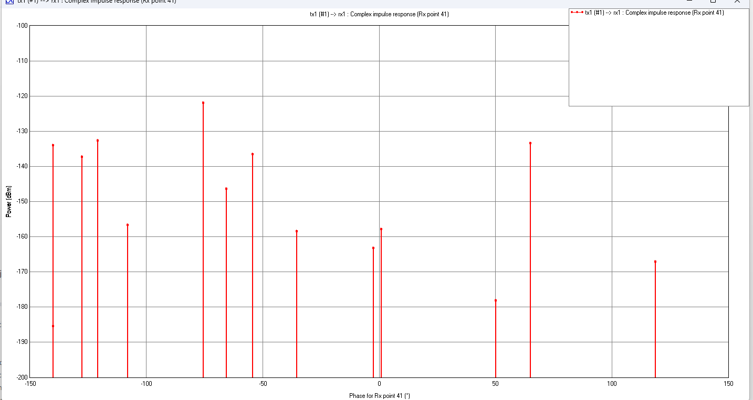
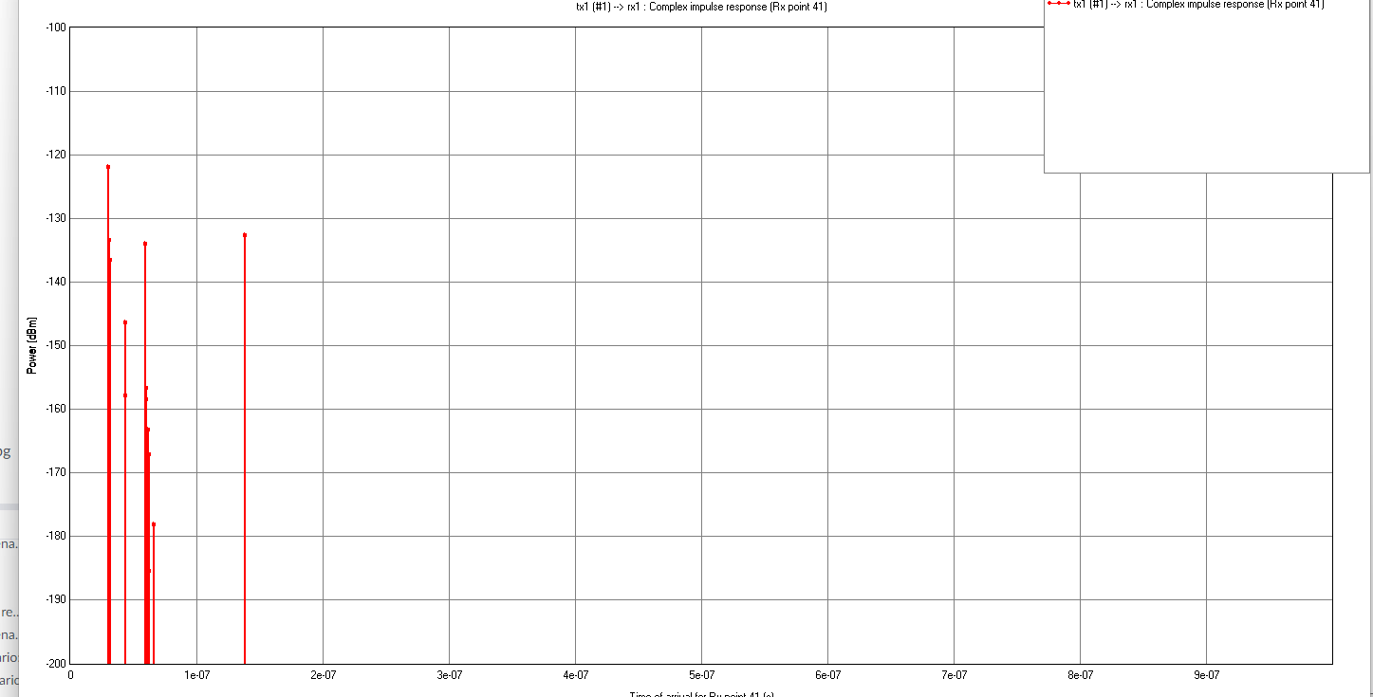
Example channel impulse response output:power vs phase,time of arrival

Slide 30
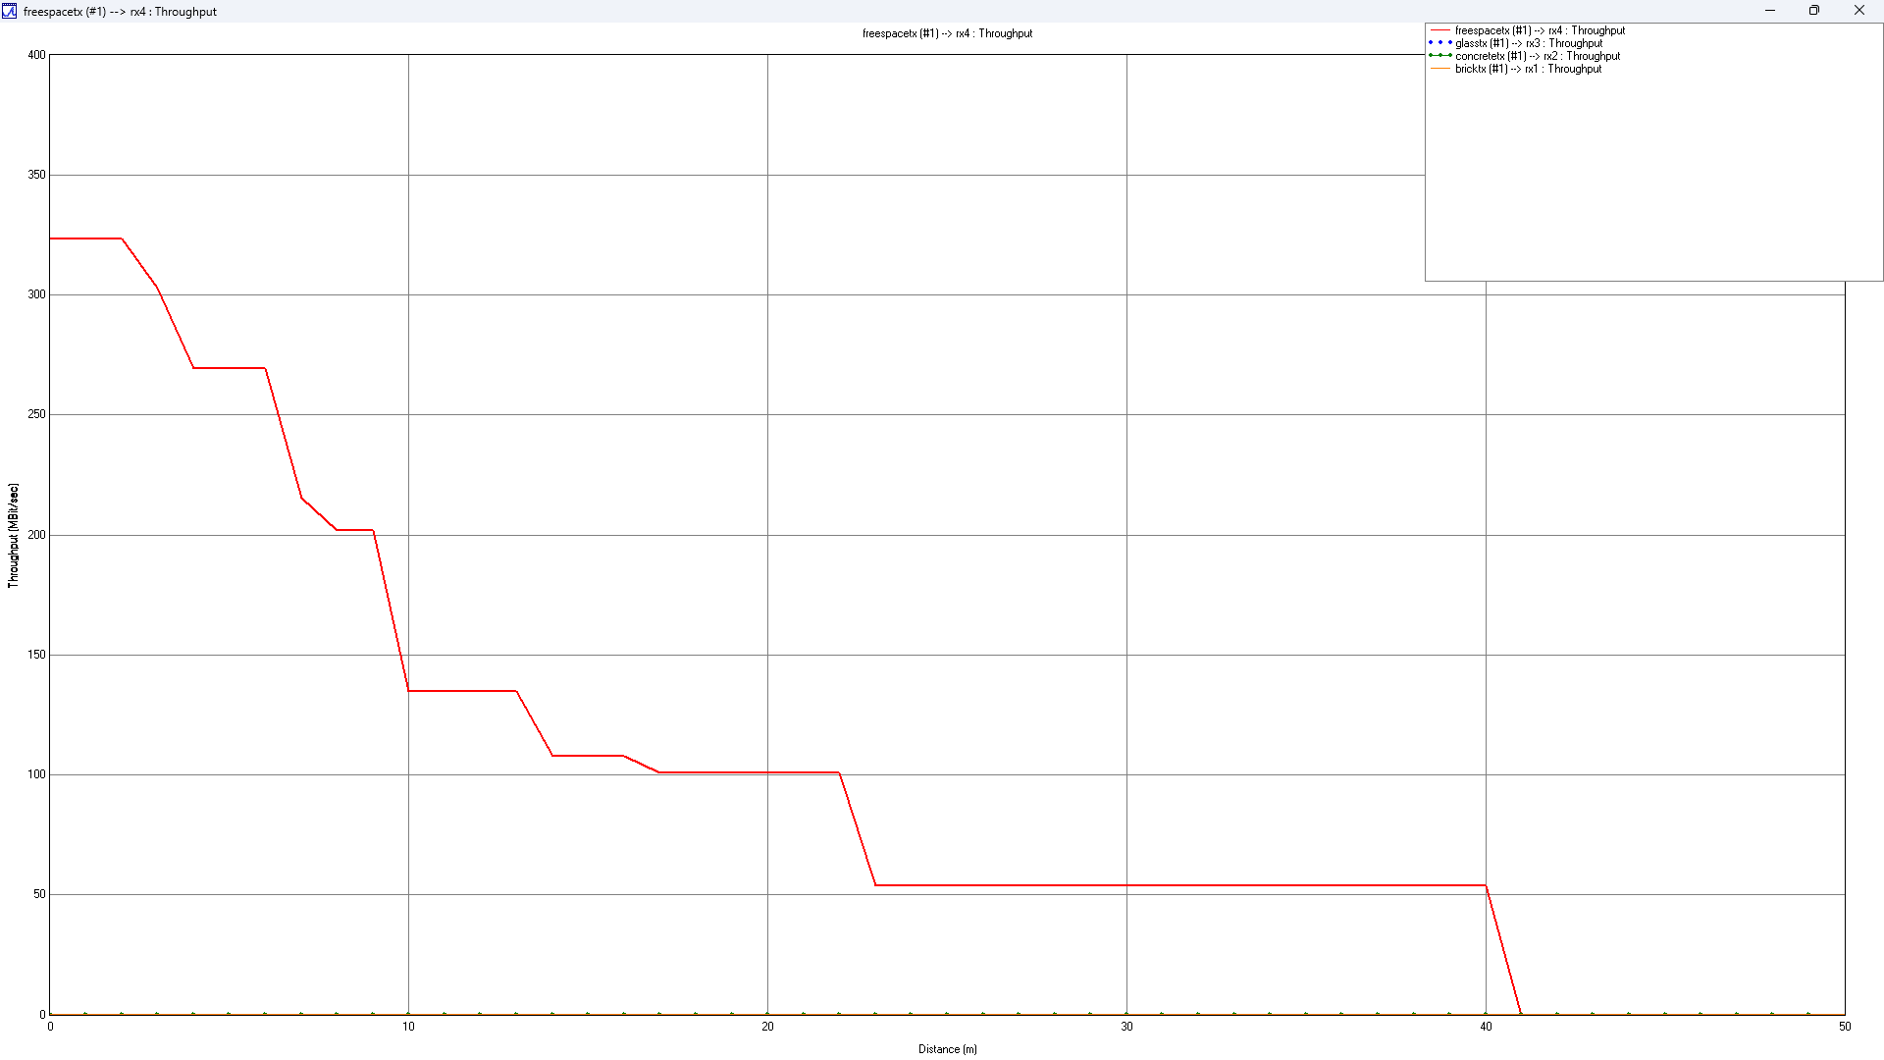
Throughput VS distance:

Slide 31
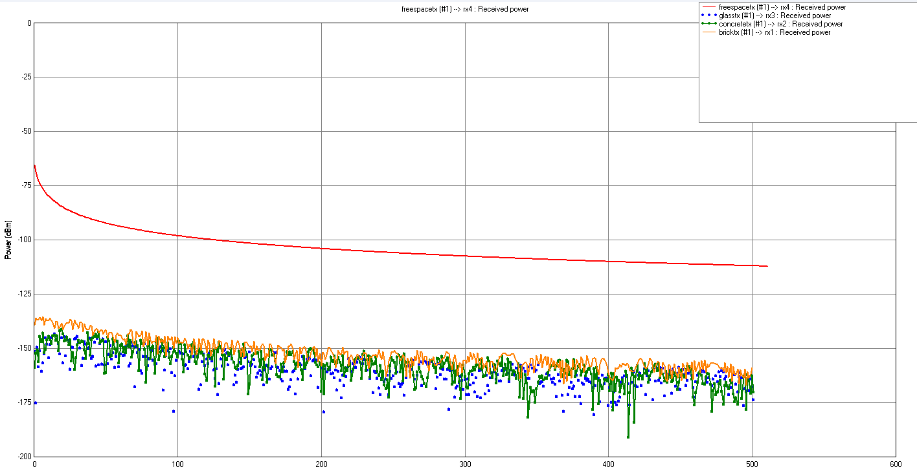
Received power through different material vs distance:

Slide 32
conclusion:
In summary, our project extensively simulated three environmental models to evaluate their impact on communication networks, focusing on key metrics such as received power, propagation paths, and throughput.
The investigation delved into diverse scenarios, including the influence of material obstacles and transmitter height in outdoor settings, coverage optimization in indoor scenarios, and the challenges posed by dense urban environments.
The findings highlight the importance of transmitter placement and environmental factors in network performance. The comprehensive dataset obtained, comprising thousands of samples for each scenario, serves as a robust foundation for training and testing machine learning models, enhancing our analytical and predictive capabilities in the realm of communication scenarios.

Slide 33
Future works:
CP-OFDM Model Development:
Constructing a Cyclic Prefix Orthogonal Frequency Division Multiplexing (CP-OFDM) model in MATLAB.
Utilizing an extensive dataset covering diverse scenarios for a detailed analysis of Bit Error Rate (BER) and throughput.
Aim: Provide nuanced insights into communication system performance under varied conditions.
Integration of Machine Learning Models:
Actively exploring the integration of machine learning models into our ongoing efforts.
Objective: Mitigate complexity in multi-environment scenarios, enhance computational efficiency, and improve channel estimation techniques.
Leveraging machine learning algorithms to streamline analysis, reduce computational time, and optimize channel characteristic estimation.
Potential impact: Significantly improve overall efficiency of simulations and analyses in diverse environmental scenarios.

Slide 34
Reference:
D. F. Carrera, C. Vargas-Rosales, N. M. Yungaicela-Naula and L. Azpilicueta, ”Comparative Study of Artificial Neural Network Based Channel Equalization Methods for mmWave Communications,” in IEEE Access, vol. 9, pp. 41678-41687, 2021, doi: 10.1109/ACCESS.2021.3065337.
L. Azpilicueta, P. Lopez-Iturri, J. Zu˜niga-Mejia, M. Celaya-Echarri, F. A. Rodr´ıguez-Corbo, C. Vargas-Rosales, et al., ”Fifth-generation (5G) mmwave spatial channel characterization for urban environments’ system analysis”, Sensors, vol. 20, no. 18, pp. 5360, 2020.
https://www.remcom.com/video-center/category/Wireless+InSite

